Slide 1
HANDWRITTEN RECOGNITION SYSTEM
LUMINEUX SDN. BHD.

Slide 2
PROJECT DEFINITION
1
HANDWRITTEN RECOGNITION SYSTEM by LUMINEUX SDN. BHD.

Slide 3
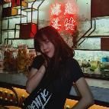

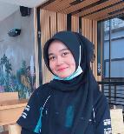
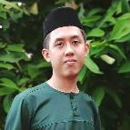
Hello! Let’s meet the team members.
I AM TAN YI WEN
Project Manager
I AM AAINAA NABILAH
Technical Manager
I AM NUR ALIS SOPHIA
Administrative Manager
I AM MUHAMMAD NUR IRFAN
Testing Manager

Slide 4
INTRODUCTION
WHAT IS HANDWRITTEN TEXT RECOGNITION?
A type of OCR that allows computers to recognize letters written by humans. Used in many sectors such as digitizing papers, autonomous driving and many more. Applications: car plate recognition, online banking, National ID recognition, etc.
HANDWRITTEN TEXT RECOGNITION SYSTEM
It can interpret humans’ handwritings by extracting them from images captured. Involves Artificial Intelligence Techniques which is Neural Network.

Slide 5
INTRODUCTION
OBJECTIVES:
To develop an intelligent system that are able to detect user's handwritten characters or words.
To construct a tool that takes an image from it as an input and extracts characters.
To develop a tool which can scan the inputted handwritten images and printed out extracted text as the output.

Slide 6
PROJECT PLANNING
2
HANDWRITTEN RECOGNITION SYSTEM by LUMINEUX SDN. BHD.

Slide 7
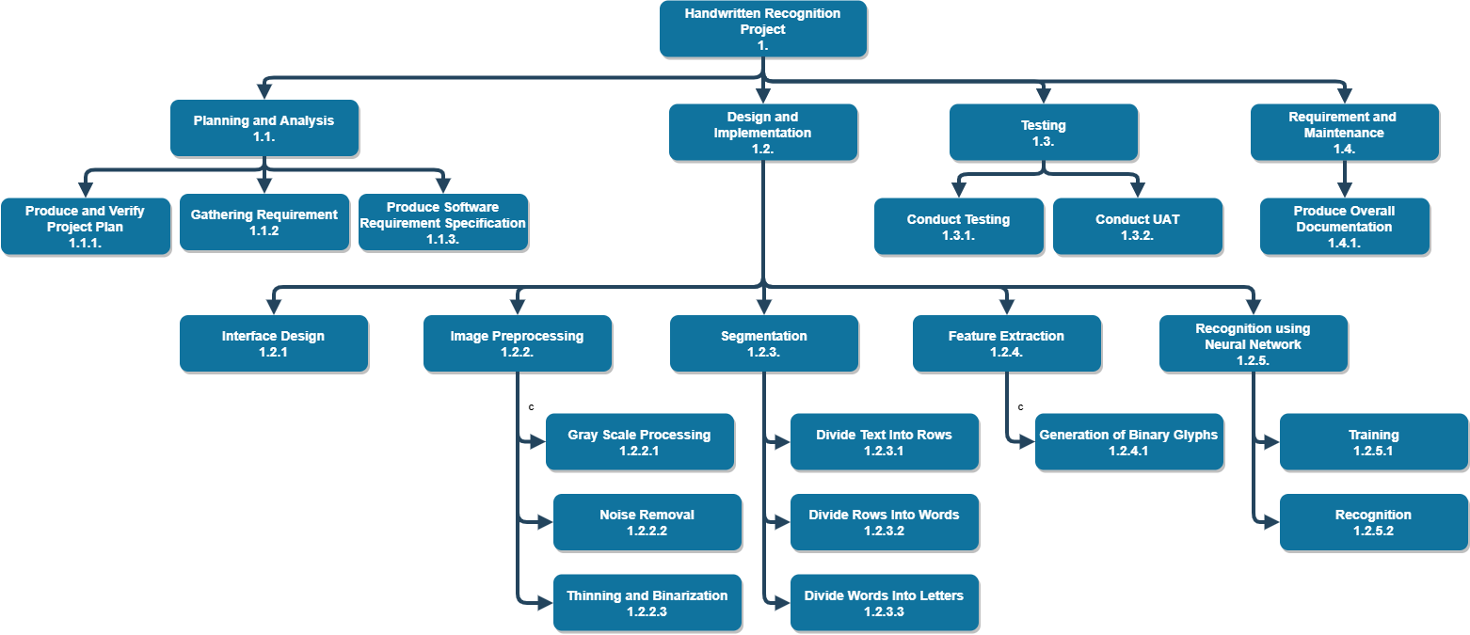
PROJECT MANAGEMENT LIFECYCLE

Slide 8
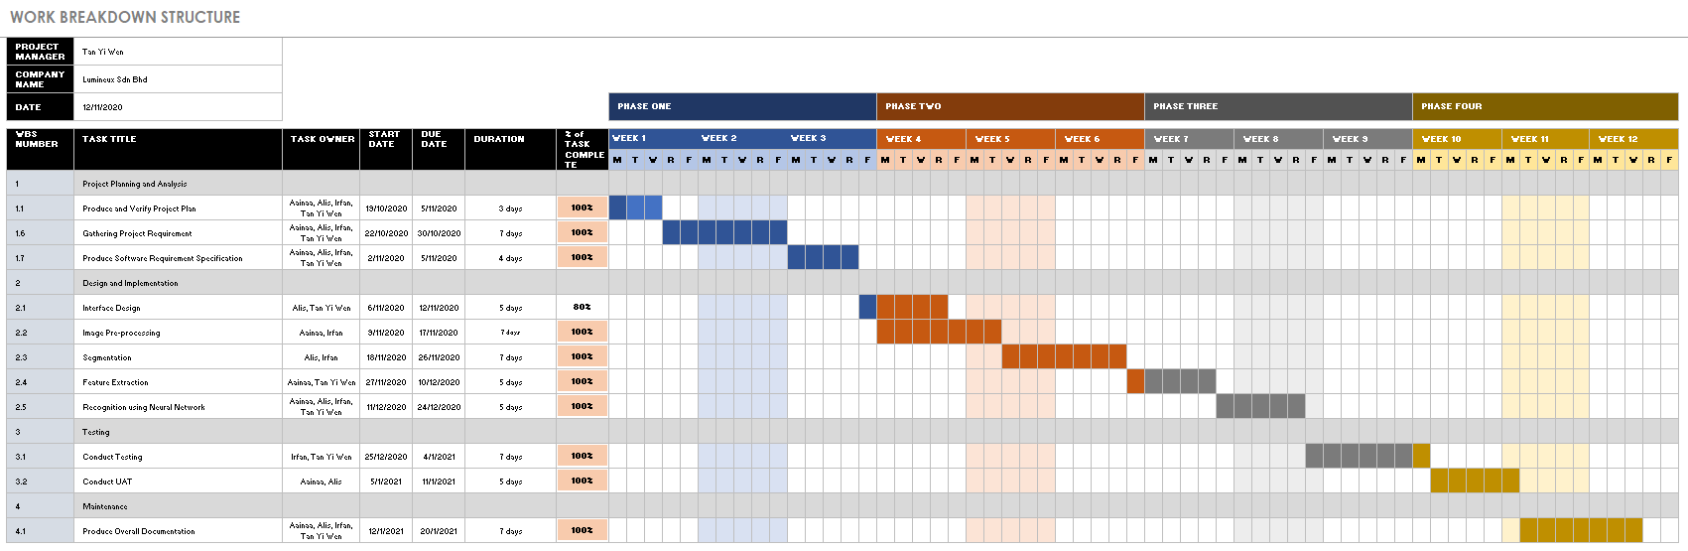
WORK BREAKDOWN STRUCTURE (WBS)

Slide 9
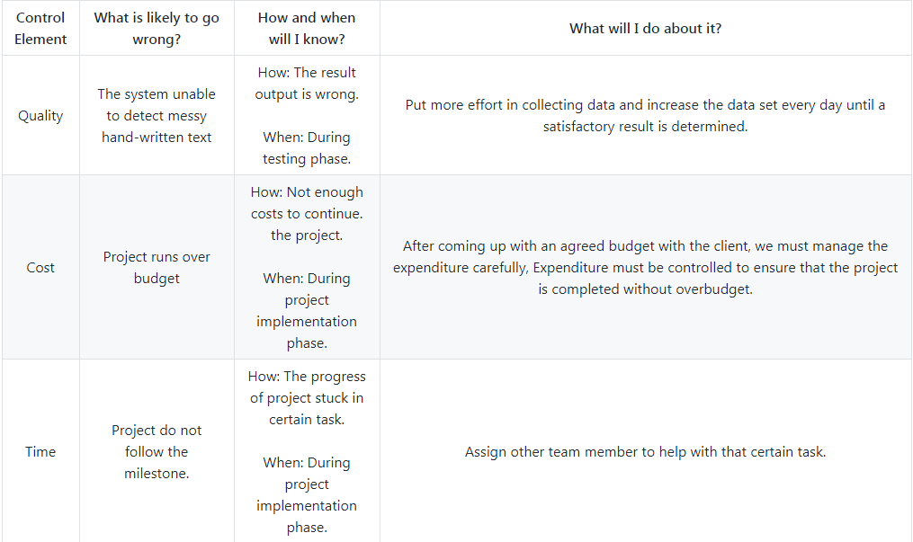
RISK IDENTIFICATION CHART (QUALITY, COST AND TIME)

Slide 10
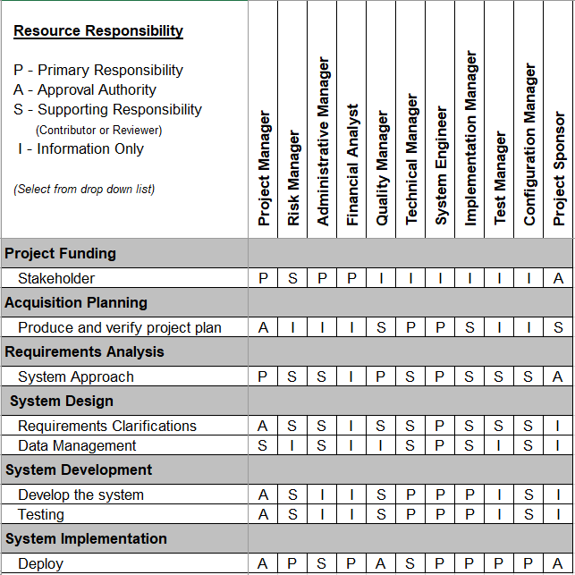
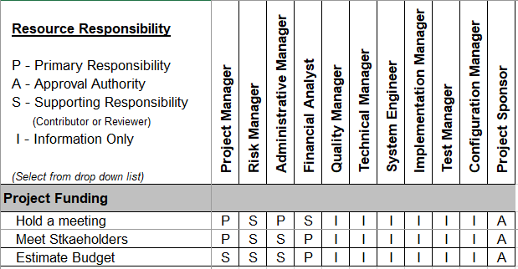
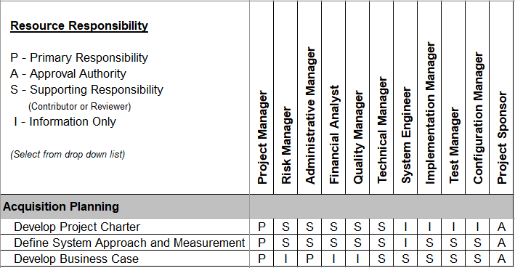
RESPONSIBILITY ASSIGNMENT MATRICES (RAM)

Slide 11
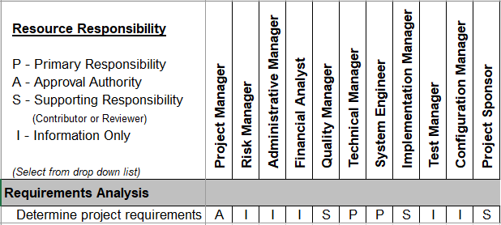
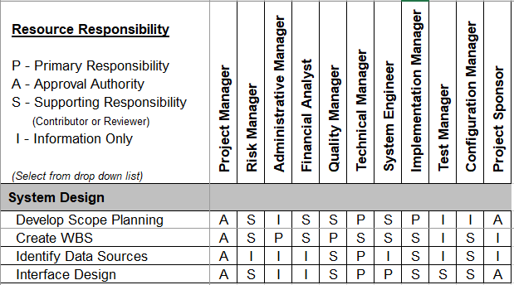
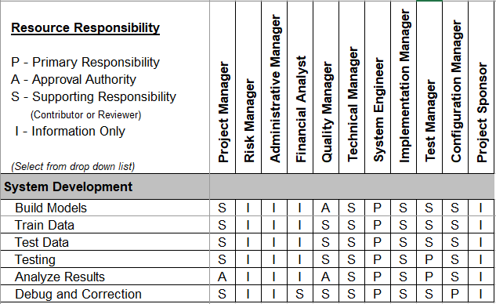
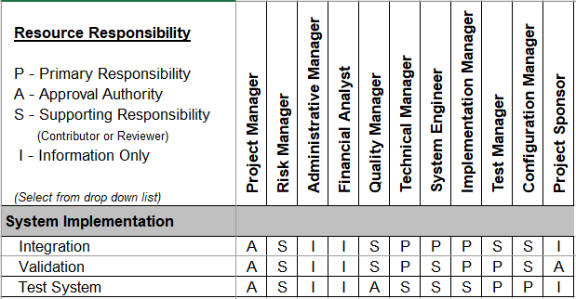
RESPONSIBILITY ASSIGNMENT MATRICES (RAM)

Slide 12
PROJECT IMPLEMENTATION
3
HANDWRITTEN RECOGNITION SYSTEM by LUMINEUX SDN. BHD.

Slide 13
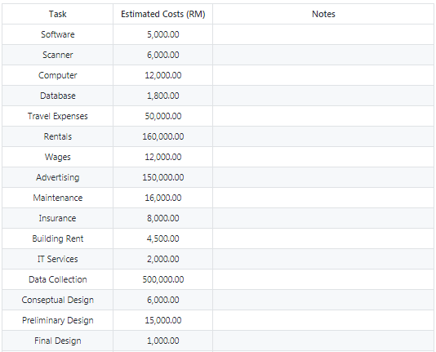
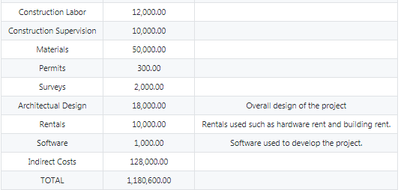
TASK AND ESTIMATED COST
TOTAL: RM 1, 180, 600.00

Slide 14
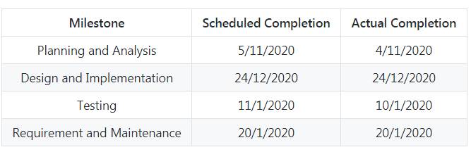
MILESTONE CHART

Slide 15
PROJECT OVERVIEW
4
HANDWRITTEN RECOGNITION SYSTEM by LUMINEUX SDN. BHD.

Slide 16


PROJECT OVERVIEW
INPUT
OUTPUT

Slide 17
PROJECT CLOSING
5
HANDWRITTEN RECOGNITION SYSTEM by LUMINEUX SDN. BHD.

Slide 18
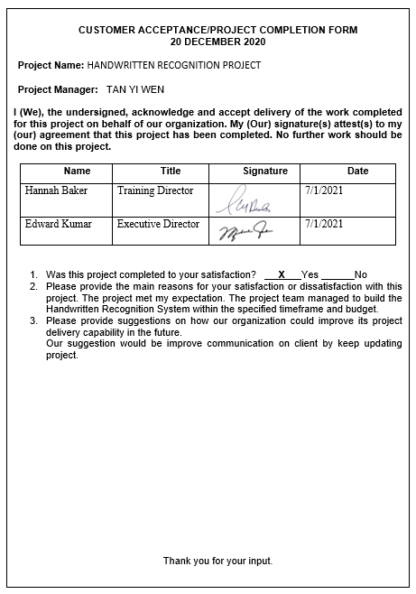
CUSTOMER ACCEPTANCE FORM
A document is used to obtain the customer's sign-off once the project is complete.

Slide 19
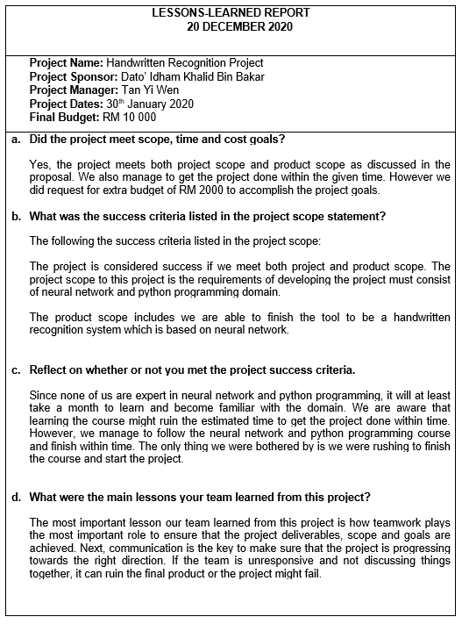
LESSON LEARNED DOCUMENT
A documented information that reflects both the positive and negative experiences of a project.

Slide 20
OTHER PROJECT CLOSING CHECKLISTS
Project results: developed successfully which is able to scan and detect the characters or words correctly.
Project schedule: The project members stick to the plan as in Gantt Chart and all progress are on track which fit to the original schedule.
Project budget: The actual budget is RM 1,079,440.00, which is RM 101,160 less than the estimate budget costs.
Success criteria: Complete the project within 4 months, and the estimated budget cost is RM 1,180,600.00

Slide 21
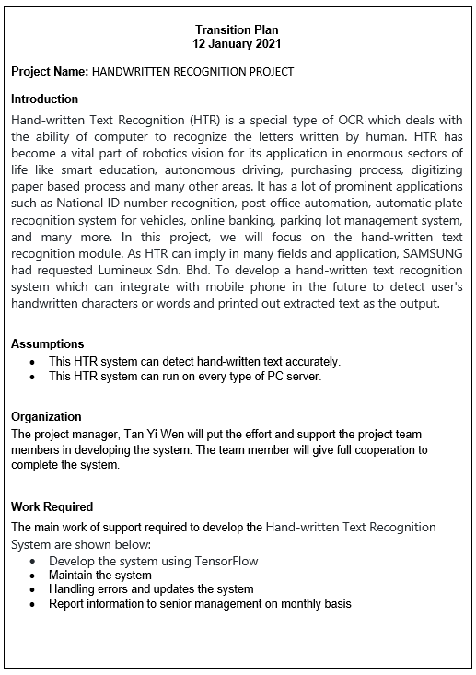
TRANSITION PLAN
A document that layout the task and activities to be performed to efficiently from the implementation phase to the maintenance phase.
The transition plan identifies the team responsibility for a successful transition, the tools, techniques, and methodologies required.

Slide 22
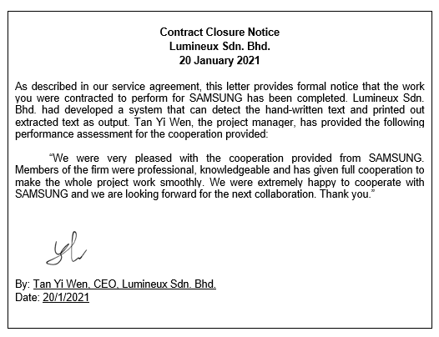
CLOSE CONTRACT
Concerned with completing and settling the task deliverables.
Determines if the work described in the contracts was completed accurately and satisfactorily.

Slide 23
SYSTEM DEMONSTRATION
6
HANDWRITTEN RECOGNITION SYSTEM by LUMINEUX SDN. BHD.

Slide 24
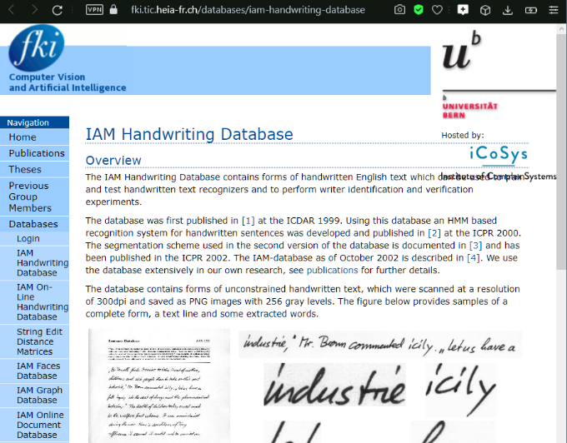
SYSTEM DEMONSTRATION
IAM dataset
Download from this site: https://fki.tic.heia-fr.ch/databases/iam-handwriting-database.

Slide 25
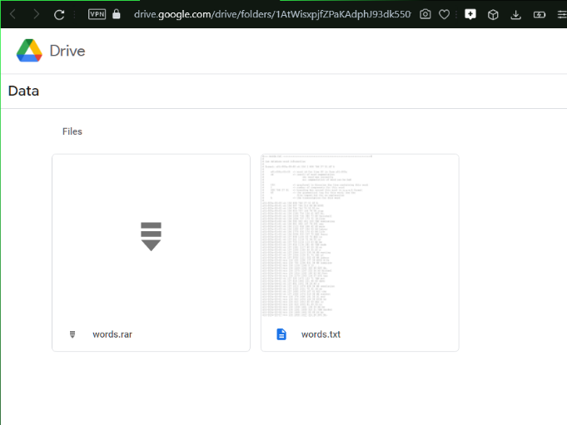
SYSTEM DEMONSTRATION
Download words/words.tgz
Download ascii/words.txt

Slide 26
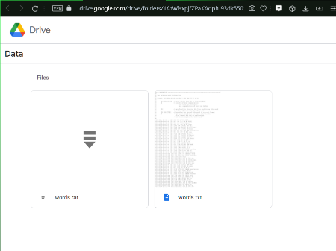
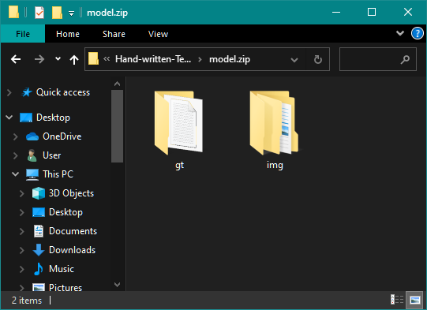
SYSTEM DEMONSTRATION
Create a directory for the dataset on your disk, and create two subdirectories: img and gt
Put words.txt into the gt directory
Put the content (directories a01, a02, ...) of words.tgz into the img directory

Slide 27

SYSTEM DEMONSTRATION
Run model using Anaconda Prompt
Go to directory of the repository and go to src folder
Command : cd [repository]\src

Slide 28
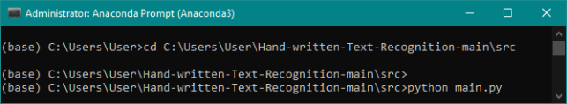
SYSTEM DEMONSTRATION
Run main.py using Python
You may need to install some softwares such as OpenCV and Tensorflow
Command : python main.py

Slide 29

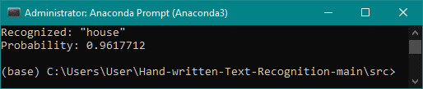
DEMO RESULT 1
INPUT
OUTPUT

Slide 30

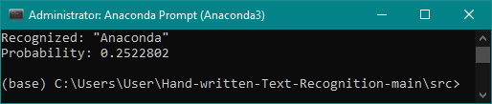
DEMO RESULT 2
INPUT
OUTPUT

Slide 31

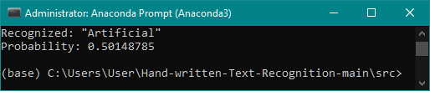
DEMO RESULT 3
INPUT
OUTPUT

Slide 32
GITHUB SITE
7
https://github.com/supcicak0/Hand-written-Text-Recognition

Slide 33
THANK YOU
to everyone involved in this project

